Slide 1
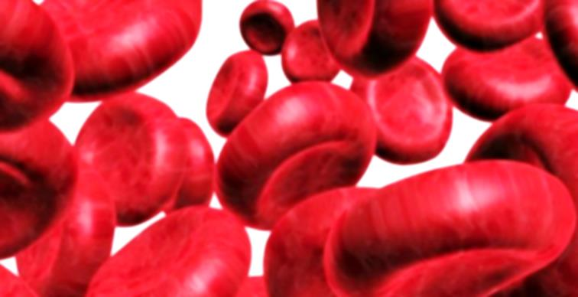
The Cellular Components of the Blood By Mr. F. John Livingston, Tutor in Medical Laboratory Technology, B.Voc Degree Programs, American College -Community College, The American College, Madurai

Slide 2
Formed Elements of the Blood
Formed elements are the cells
Comprise 45% of blood volume
Erythrocytes, leukocytes, and platelets make up the formed elements
WBCs are complete cells, contain nucleus and organelles.
RBCs have no nuclei or organelles,
Platelets are just cell fragments, no nucleus present
Life Span: Most formed elements survive in the bloodstream for only a few days. RBCs 120 days, WBCs uncertain and Platelets for 3- 9 days

Slide 3
Erythrocytes (RBCs) * Biconcave Shape * 1/3 Centre Pallor & 2/3 Haemoglobinized area * Size: 7.5 micron mu diameter and 2.0 micron mu in thickness

Slide 4
Functions of Red Blood Cells
Transports Gases :
Carry Oxygen (O2) from the lungs to the body tissues
Carry( Removes) Carbon dioxide (CO2)as a waste from the tissues to the lungs.
Haemoglobin(Hgb): The blood pigment involves in transport of gases.
Helps maintain “Acid- Base Balance”.

Slide 5
Leukocytes
Granulocytes ( White blood Cells with granules in their cytoplasm)
Ex: Neutrophil, Eosinophil & Basophil
Agranulocytes( White blood Cells with out granules in their cytoplasm)
Ex: Lymphocyte & Monocyte
* Macrophage( Nucleated Cells): Immune cells that recognize, engulf and destroy target cells – they accumulate damaged and dead cells

Slide 6
Granulocytes: Neutrophils (Polymorphonuclear leukocytes) Neutrophil and Band form
Size: 12-14 micron mu
65-75% of total WBC’s are neutrophils
Contains Azurophilic ( Neutral color) granules
Take up both acidic and basic dyes
Give the cytoplasm a lilac color, light bluish pink
Contain peroxidases, hydrolytic enzymes, and defensins (antibiotic in nature like proteins)
Neutrophils are our body’s bacteria slayers

Slide 7
Granulocytes: Eosinophils
Size: 12-14 micron mu
1–4% of WBCs are Eosinophis
Orange- red granule
Spectacle shape (bilobed) nuclei
Function:
Lead the body’s counter attack against parasitic infections
Lessen the severity of allergies by phagocytizing immune complexes (ending allergic reactions)

Slide 8
Granulocytes: Basophils
Size: 8-10 micron mu
0.5-1% of all WBCs are Basophils
Have Kidney or bean shaped nuclei with one or two conspicuous constrictions
Large and small purplish-black (basophilic) granules that contain histamine
Granules are numerous and fully occupy the cytoplasm and even present over the nucleus - nucleus is not clearly seen.
Functionally similar to mast cells ( a migrant cells of connective tissue, contains histamine & heparin, involves in immune & neuro-immune system
Histamine: Inflammatory chemical that acts as a vasodilator and attracts other WBCs (antihistamines counter this effect)

Slide 9
Agranulocytes: Lymphocyte
Size: Large Lymphocytes: 12-15 micron mu
(Small Lymphocytes: 7-8 micron mu)
20-25% or more of WBCs are Lymphocytes
Nucleus: Large, dark-purple, circular nuclei made up of fully condensed chromatin with a thin rim of blue cytoplasm ( only very little amount of cytoplasm in small lymphocytes)
Found mostly enmeshed in lymphoid tissue (some are circulate in the blood)
Most important cells of the immune system
There are two types of lymphocytes: T cells and B cells
T cells - attack foreign cells directly
B cells - give rise to plasma cells, which produce antibodies

Slide 10
Monocytes
Size: 16-22 micro mu
3–7% of leukocytes are Monocytes
Largest and thinnest leukocytes
Kidney-shaped thin nuclei, made up of fine thin chromatin, light can pass through it.
Plenty of sky blue cytoplasm with vacuoles.
Called as Scavenger cells, removes dead cells from the circulation
Phagocytosis in action(engulfing –eating up)
They leave the circulation, enter tissue, and differentiate into macrophages

Slide 11
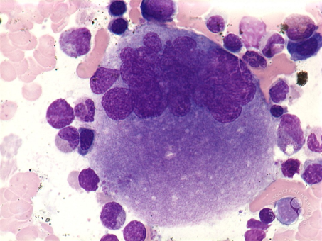
Platelets
Size: 1-3 micron mu
Normal: 1,50,000 – 4,00,000/cumm
Their granules contain serotonin, Ca2+, enzymes, ADP, and platelet-derived growth factor (PDGF)
Platelets involves in clotting mechanism by forming a temporary plug that helps seal breaks in blood vessels
Platelets not involved in clotting are kept inactive by Nitric Oxide (NO) and prostaglandins

Slide 12
White Blood Cells

Slide 13
The End

